Slide 1


Looking
Back (2019)
Forward (2020)
Lonnie L. Howard
Professional Development Day
(January 13, 2020)

Slide 2
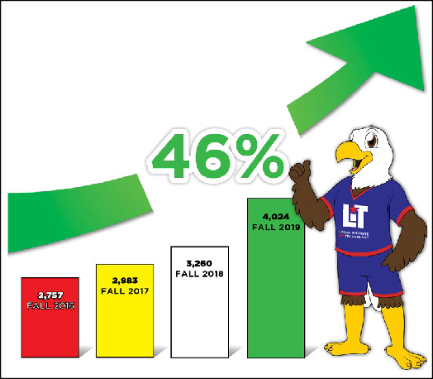
Looking Back (2019)
- Enrollment -
86th Legislative Session
$1M Truck Driving.
TSUS Tuition ($8.7M).
25% Reduction.
Dual Credit ($50/SCH).
Dual Credit
(BISD 14.9% of Total)

Slide 3
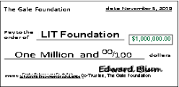

Looking Back (2019)
- College Gifts -
Fundraising
(42-Months)
Two $1M Donations
(Nov. & Dec.)
Year | Amount
2016 (Jul-Dec) | $753,183
2017 | $1,174,913
2018 | $1,403,708
2019 | $3,196,042
Grand Total | $6,527,846
Mrs. Gale

Slide 4
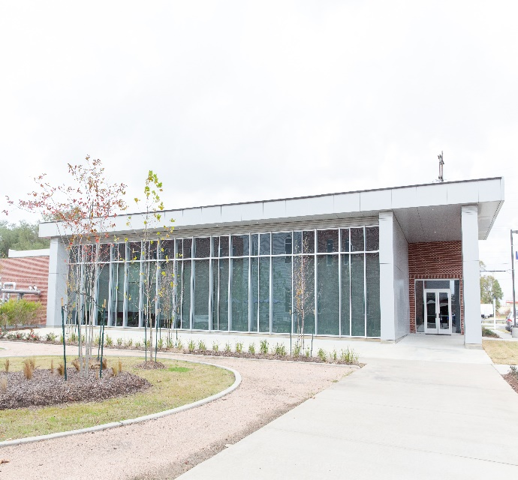
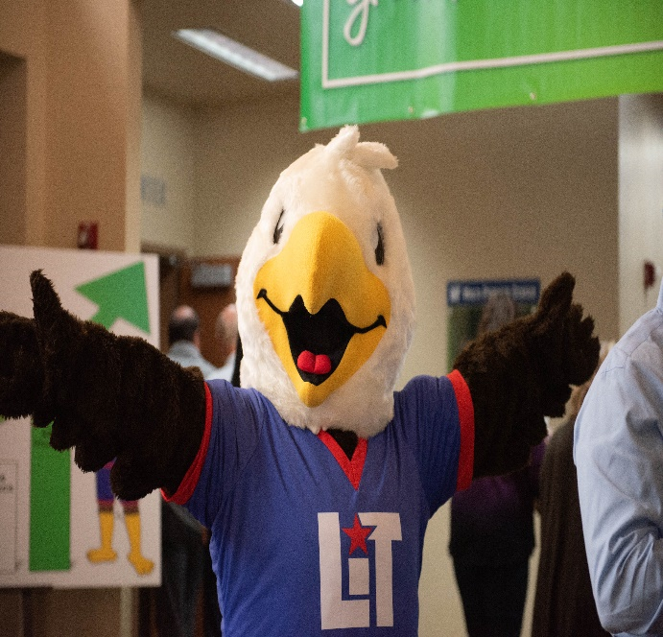
Looking Back (2019)
- Student Success -
Eagle’s Nest Opens
(Sept.)
New Mascot
(Sept.)
One-Stop-Shop
(18,700 Sq. Ft.)
Baldy

Slide 5

Looking Back (2019)
- College Culture -
Our Environment
(Jan. - Dec.)
Internal and External Stakeholders Care.
Pay Higher Salaries.
Benefits & Perks.
The Best & Brightest.
Best Place to Work
(Dec.)

Slide 6
Looking Forward (2020)
- LIT Strategic Plan -
Its (3) Strategic Goals:
Increase Student Access, Success, and Reduce Debt.
Become more Responsive to the Community and Industry.
Promote Institutional Excellence.
(2020 - 2025)

Slide 7
Best for the Students
Looking Forward (2020)
- Strategic Goal 1 -
Increase Student Access, Success, and Reduce Debt:
Have a statewide footprint as ‘big as Texas.’ Enroll 10,000 students by 2025.
Make learning convenient for adults (8-wk., weekend, online, and accept prior learning).
“Hand Holding is OK.” Develop a 1st Yr. college experience for all students.
Reduce Debt: graduate students faster!

Slide 8
Looking Forward (2020)
- Strategic Goal 2 -
Be more Responsive to the Community and Industry:
Provide industry with noncredit workforce solutions (24/7). Edu. in weeks not years.
Become a Neighborhood College (civic events, meetings, and emergencies).
Encourage faculty to do service-learning projects in the community.
Upskilling South Park…revitalization.

Slide 9

Looking Forward (2020)
- Strategic Goal 3 -
Promote Institutional Excellence:
Continue to improve our college culture; ethics, civility, and workplace behaviors.
Implement an enrollment management plan, and focus program review and viability.
Continue our efficient business model; raises come from local money.
Increase employee innovation.

Slide 10
Back (2019)
Forward (2020)
- Miscellaneous Topics -
Questions & Answers

